Slide 1

Cyber crime

Slide 2
INTRODUCTION
MALWARE
STATISTICS
Law and Punishments
Conclusion
PREFACE

Slide 3
Presented by
Md.Nazmul Hossain
ID:22201091

Slide 4
Presented by
Mahinur Akther
ID:22201100

Slide 5
Presented by
Mushfiq Hassan
ID:22201093

Slide 6
Presented TO
Tahira Alam
Assistant Professor
Abdullah Mahmud Sakib
Teaching Assistant
University Of Asia Pacific

Slide 7
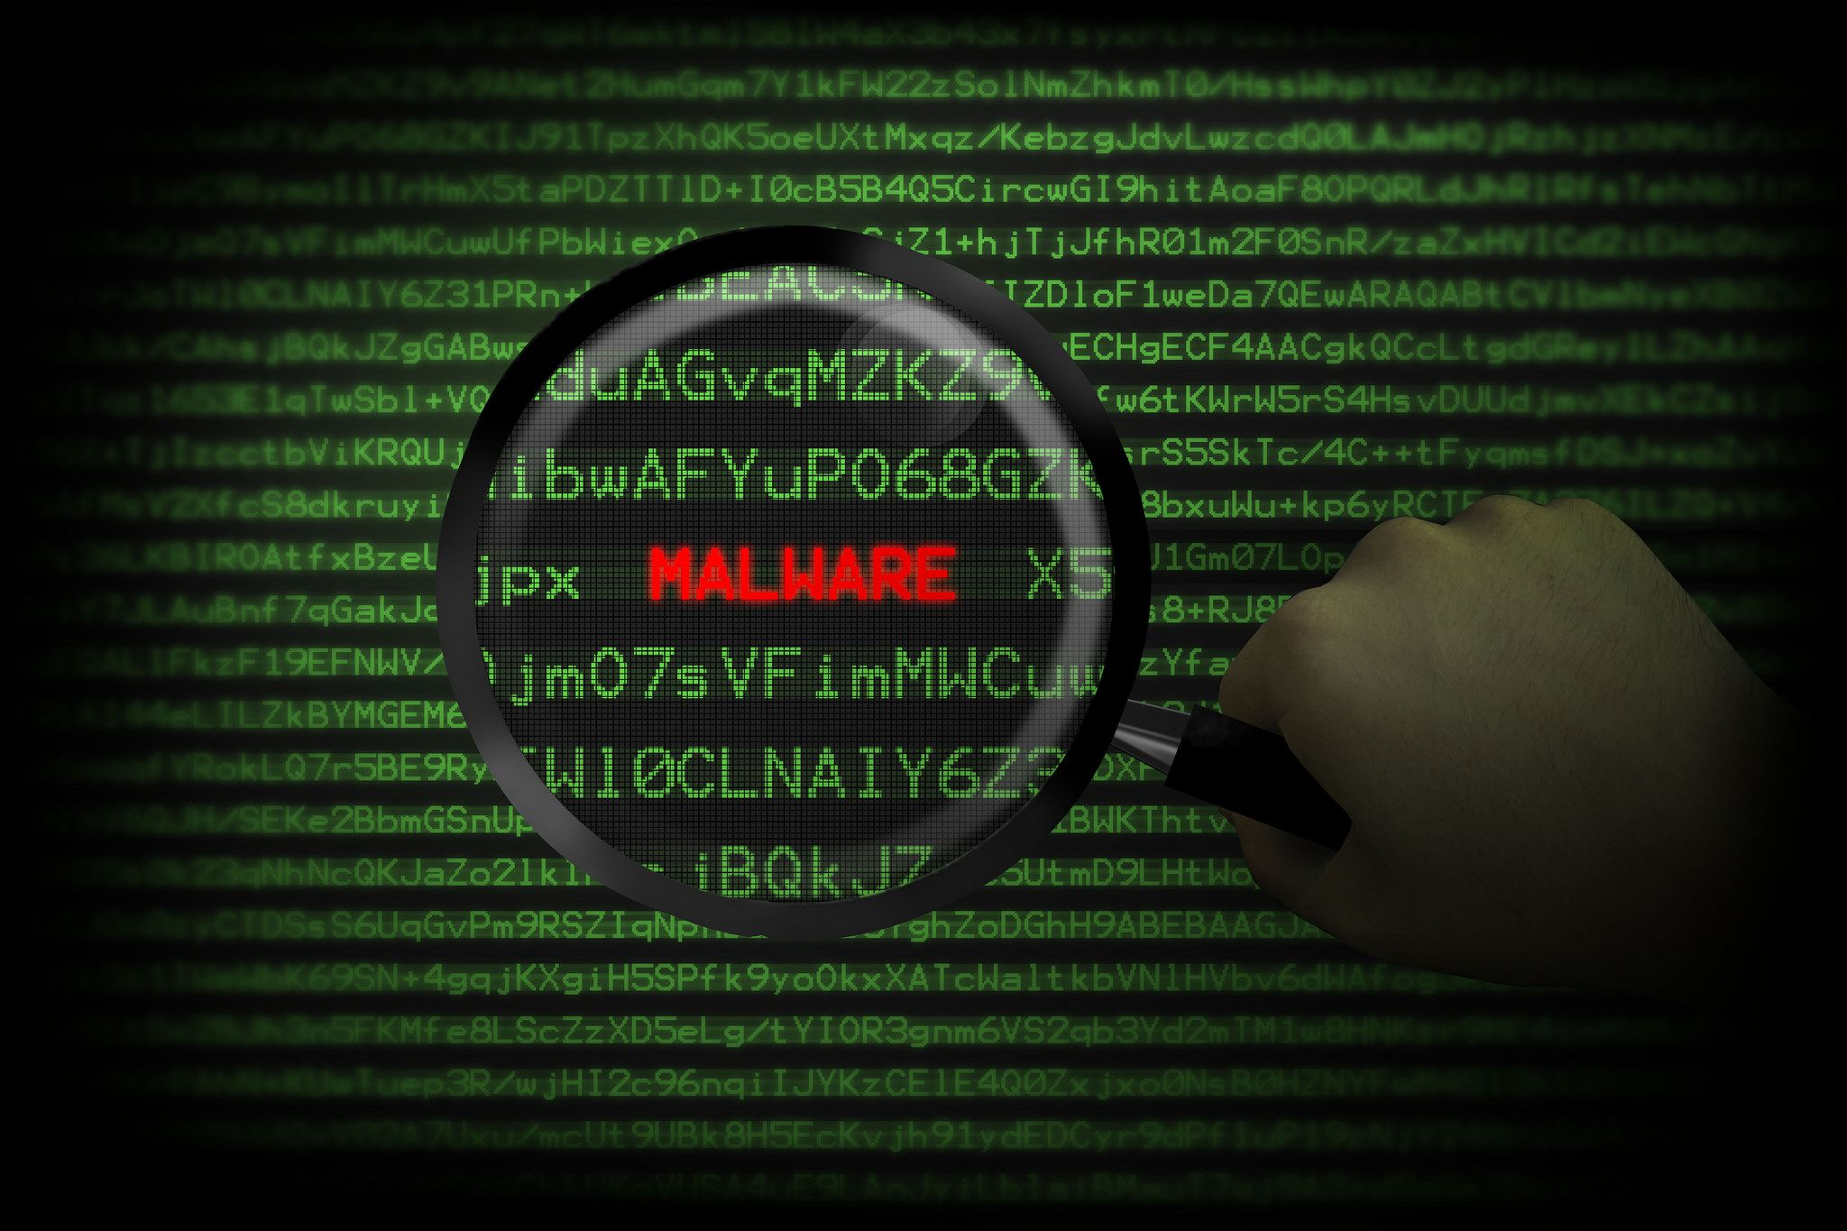
MALWARE

Slide 8

Virus
Trojans Horse
Rootkits
Worms
Spyware

Slide 9




LAW AND PUNISHMENTS
The role of cybercrime law
Different types of laws
Substantive law
ICT Act and Penalties
Cybercrime penalties and ICT Act

Slide 10


Precautions &Conclusion
Use a full-service internet security
Use strong passwords
Keep your software updated
Manage your social media setting
Strengthen your home network
Talk to your children about the internet

Slide 11

Any doubts????
Any questions????

Slide 12
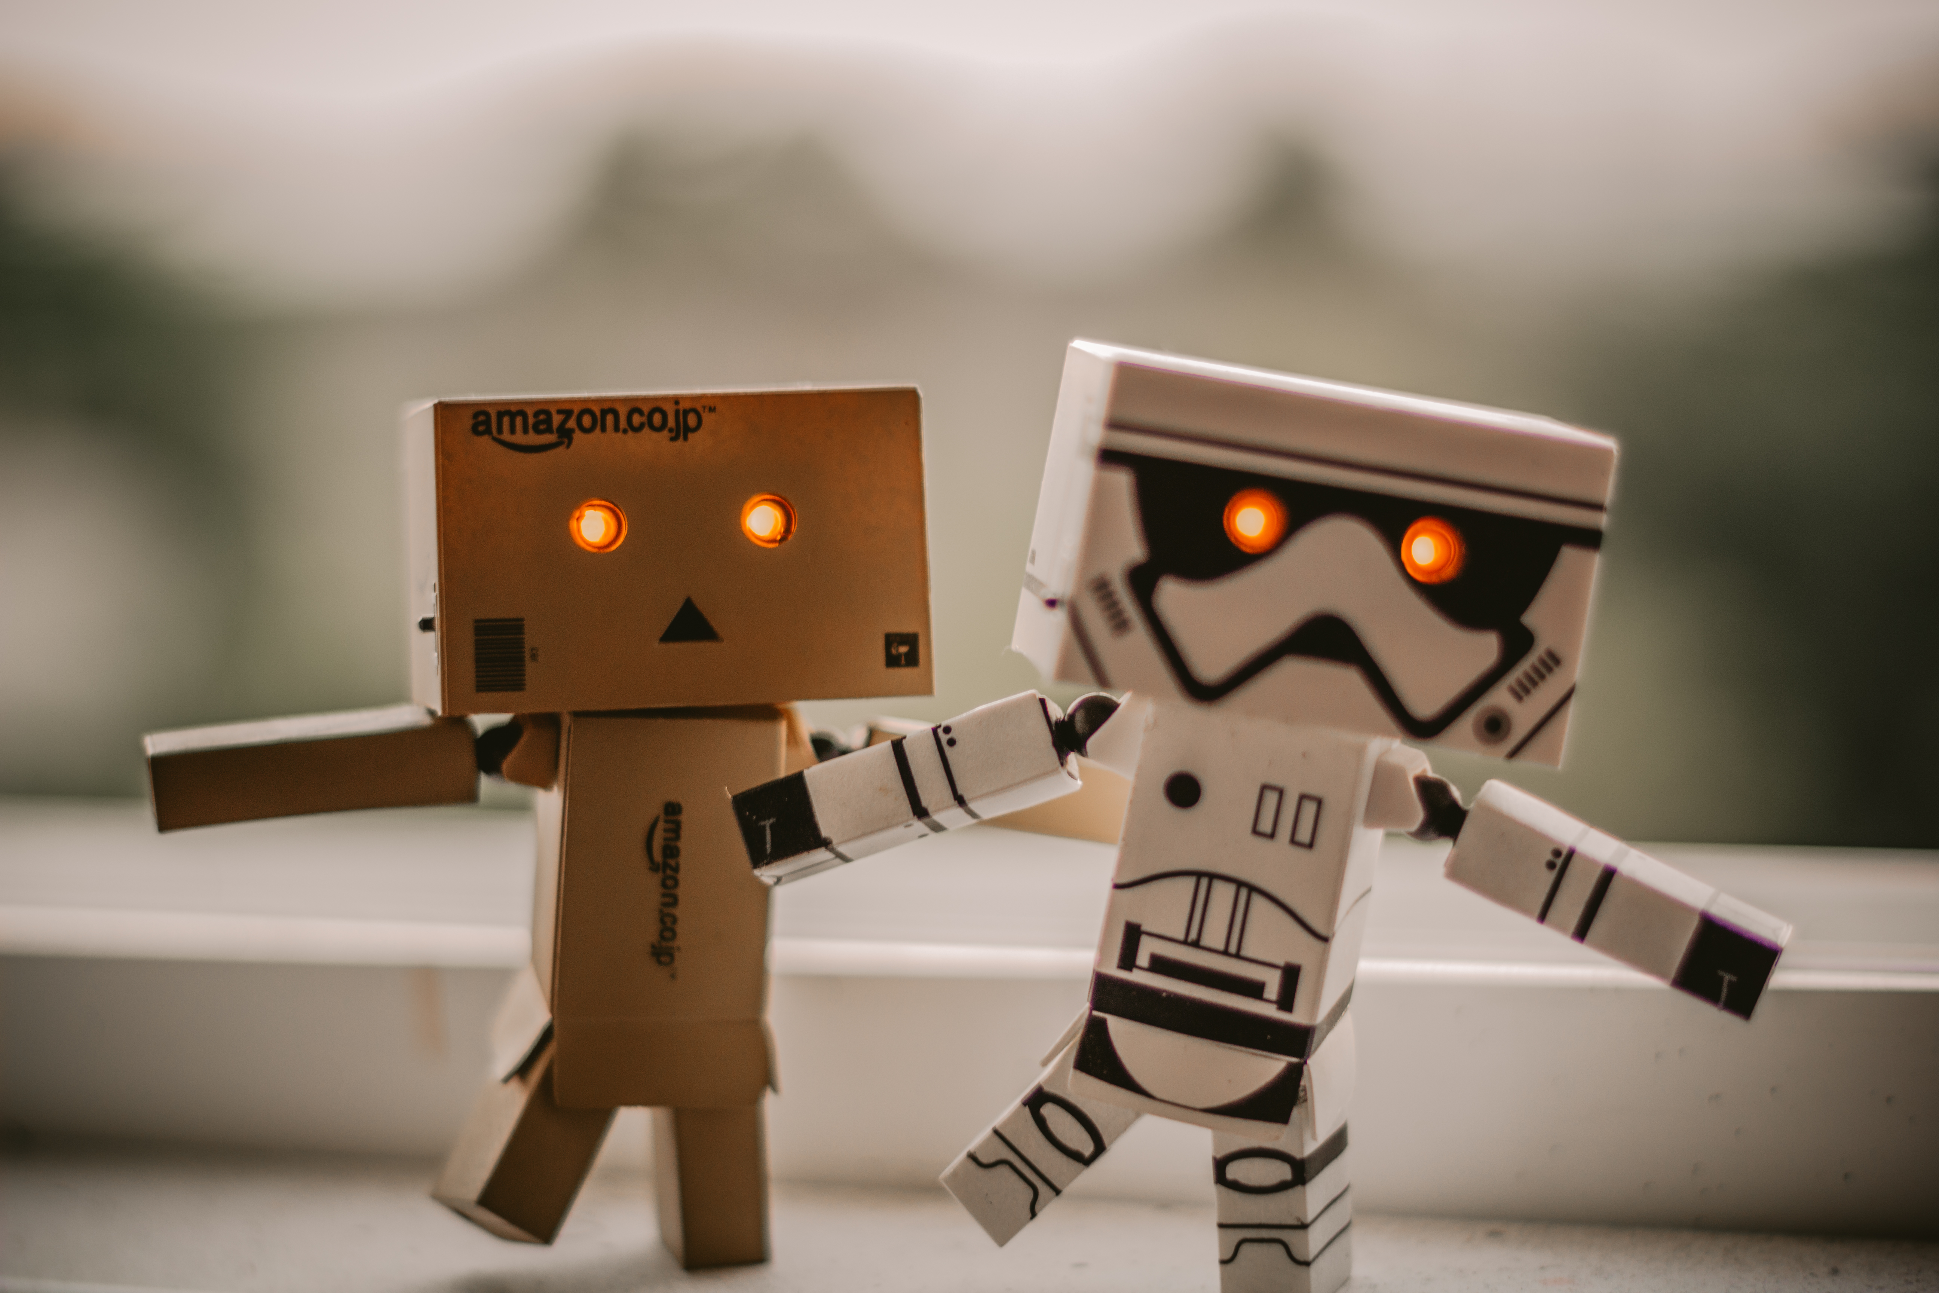
THANK YOU

